Slide 1

Working with Assistants Part 5: Creating Messages

Slide 2
Brad Goreski
“I want to keep my clients happy, and the pressure's on me as the boss to manage my three assistants and make sure that everything is getting done. There's less time for tears and more time for bossing people around.”

Slide 3



Notes:
https://www.youtube.com/channel/UC35ZpwldGw7ZJ5R-2sLijzw

Slide 4
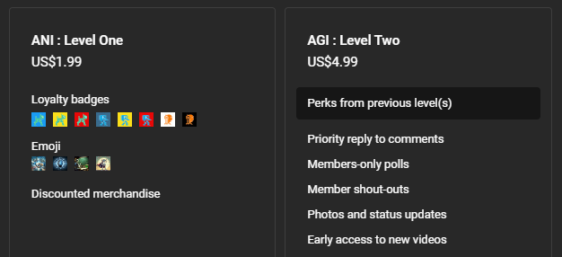
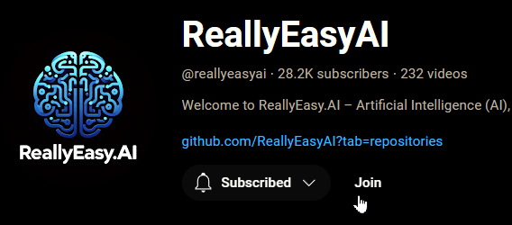
Membership has its privileges
Notes:
https://www.youtube.com/channel/UC35ZpwldGw7ZJ5R-2sLijzw/join

Slide 5
Creating Assistants & Threads Review
Let’s Make Some Objects!
Notes:
https://platform.openai.com/docs/api-reference/assistants/createAssistant

Slide 6
Demo: Creating Assistants Review
from openai import OpenAI
# Create an instance of the OpenAI class
# This assumes you have the OPENAI_API_KEY environment variable set
client = OpenAI()
# Create an assistant that uses code interpreter.
assistant = client.beta.assistants.create(
model="gpt-4-turbo",
instructions="You are a helpful assistant.",
name="Message Holder",
metadata={
"holds_messages": "True",
"likes_messages": "True",
},
temperature=1,
top_p=1,
)

Slide 7
Demo: Creating Threads Review
from openai import OpenAI
client = OpenAI()
thread_holding_messages = client.beta.threads.create(
metadata={
"user": "abc123"
}
)
print(thread_holding_messages)

Slide 8
Understanding Messages
Getting the Concept Down, Again

Slide 9
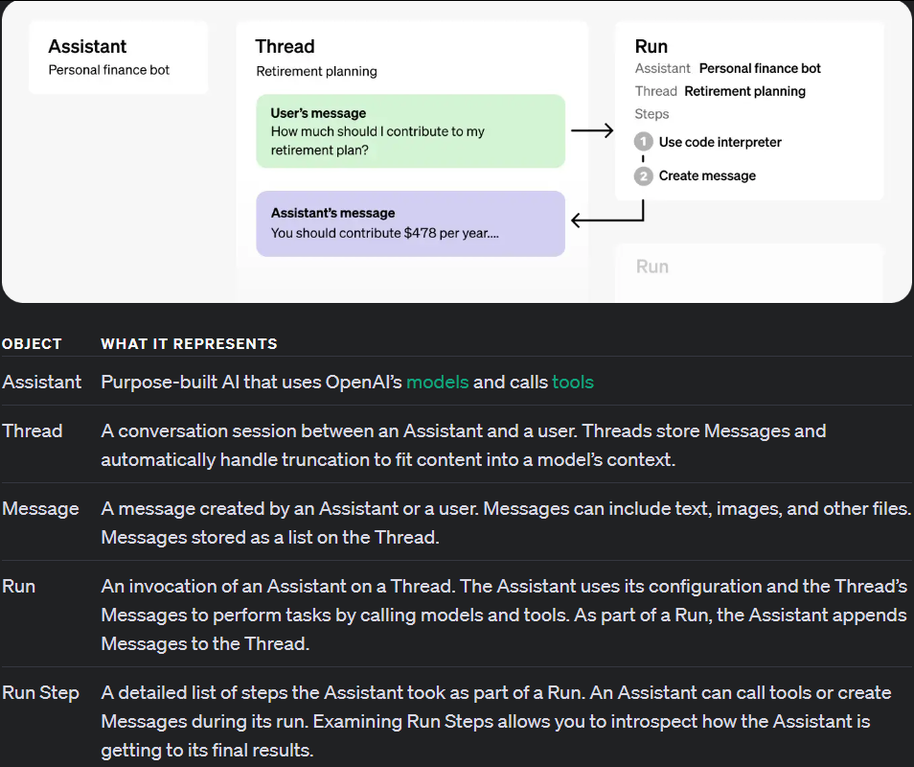
You Are Here
Notes:
https://platform.openai.com/docs/assistants/how-it-works

Slide 10
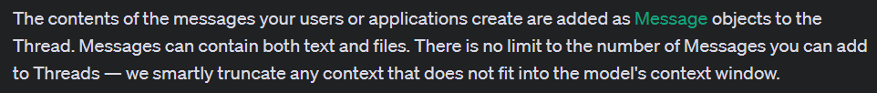
ASSISTANT ONE
THREAD ONE
ASSISTANT TWO
RUNS
MESSAGE ONE
MESSAGE TWO
MESSAGE THREE
ASSISTANT THREE
Notes:
https://platform.openai.com/docs/assistants/overview/step-3-add-a-message-to-the-thread

Slide 11
^^^^
Older
Entire Conversation
Newer
vvvv
Lost Conversation
Context Window

Slide 12
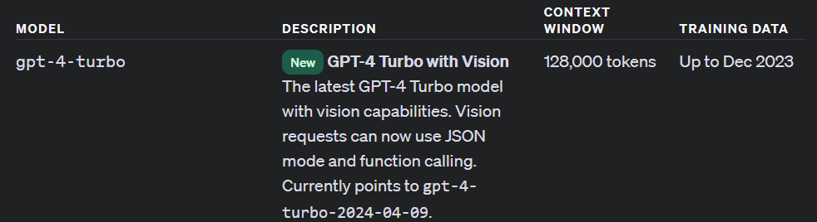
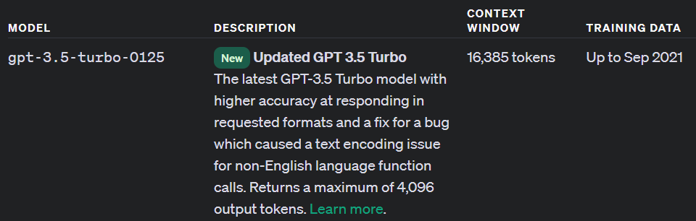
Notes:
https://platform.openai.com/docs/models/gpt-4-turbo-and-gpt-4
https://platform.openai.com/docs/models/gpt-3-5-turbo

Slide 13
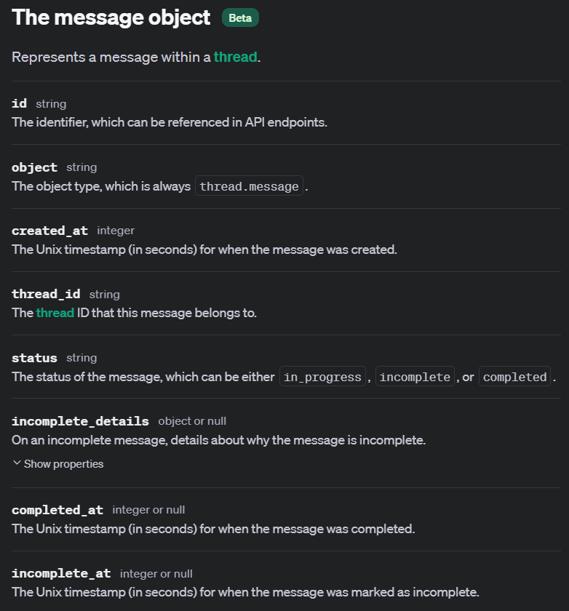
Notes:
https://platform.openai.com/docs/api-reference/messages/object

Slide 14
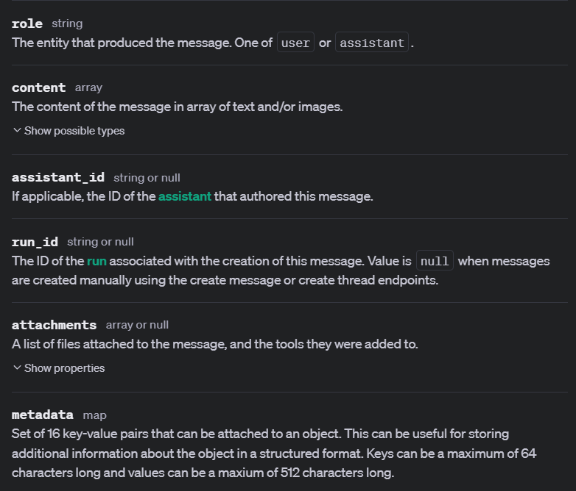
Notes:
https://platform.openai.com/docs/api-reference/messages/object

Slide 15
Creating Messages
Stuff We Want to Say
Notes:
https://platform.openai.com/docs/api-reference/messages/createMessage

Slide 16
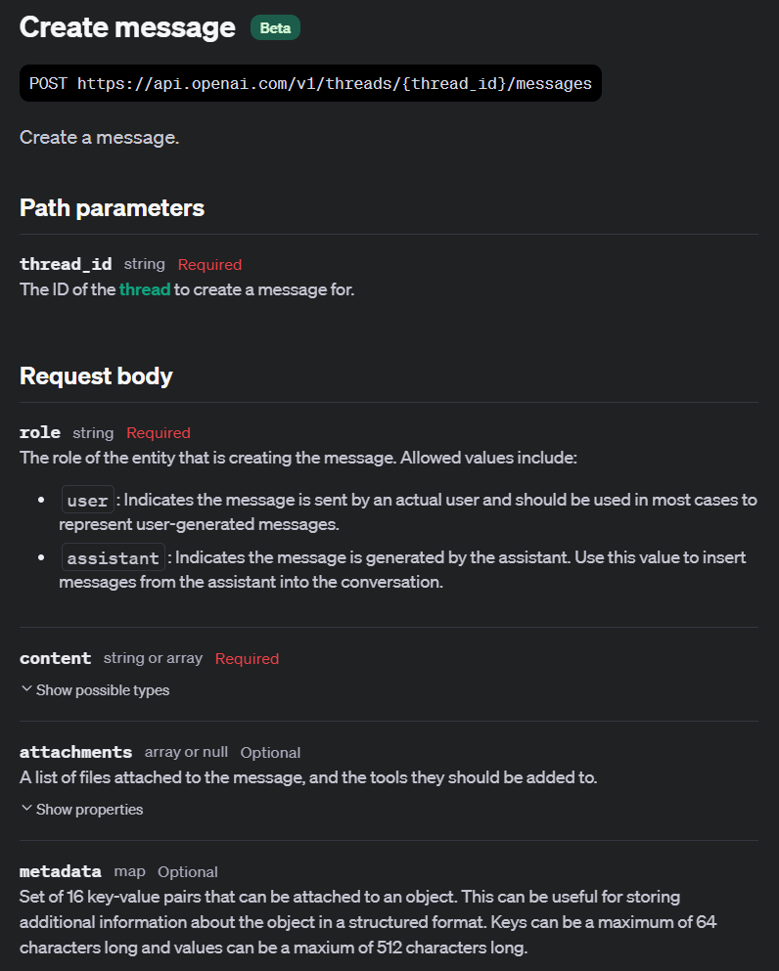

Slide 17
Demo: Creating Our First Message
message = client.beta.threads.messages.create(
thread_id=thread_holding_messages.id,
role="user",
content="What is a penguin?",
metadata={"key": "value"}
)

Slide 18
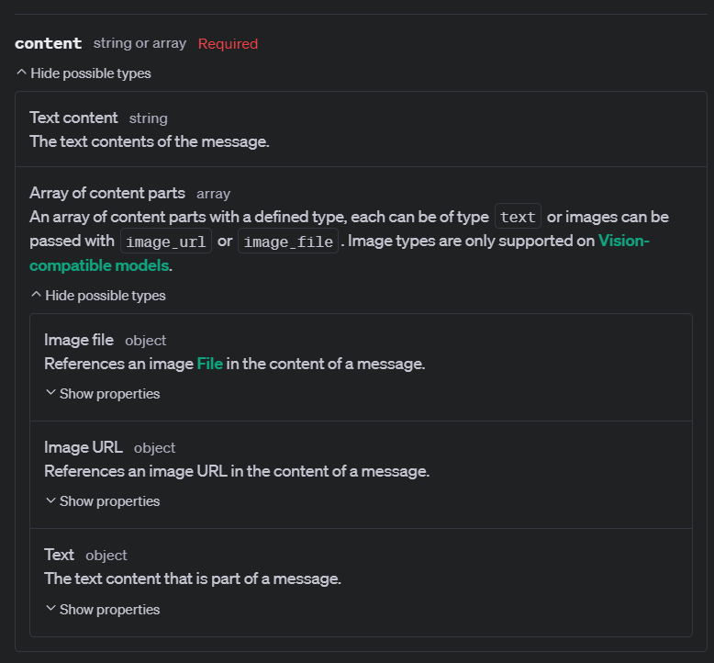

Slide 19
Demo: Creating a Message for Vision
file = client.files.create(
file=open("./artifacts/PuppyDog.jpg", "rb"),
purpose="vision"
)
message_vision = client.beta.threads.messages.create(
thread_id=thread_holding_messages.id,
role="user",
content=[
{
"type": "text",
"text": "What is the difference between these images?"
},
{
"type": "image_url",
"image_url": {"url": "https://en.wikipedia.org/wiki/File:Cat_August_2010-4.jpg"}
},
{
"type": "image_file",
"image_file": {"file_id": file.id}
},
],
)

Slide 20
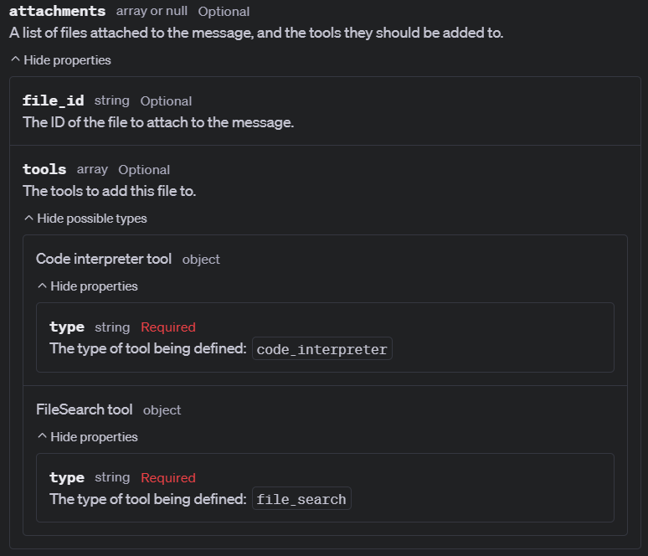

Slide 21
Demo: Attaching Files for Tool Use
data_file = client.files.create(
file=open("./artifacts/penguins_size.csv", "rb"),
purpose="assistants"
)
message_code_interpreter = client.beta.threads.messages.create(
thread_id=thread_holding_messages.id,
role="user",
content="Create three visualizations based on the data in this file.",
attachments=[
{
"file_id": data_file.id,
"tools": [{"type": "code_interpreter"}]
}
]
)

Slide 22
